Slide 1

Capstone Project Presentation
Team 8:
Maisha Khatoon (100899259)
Bhudev Nevaniya (100848467)
Pujan Bhusal (100890113)
Shreeraj Shah (100848468)

Slide 2
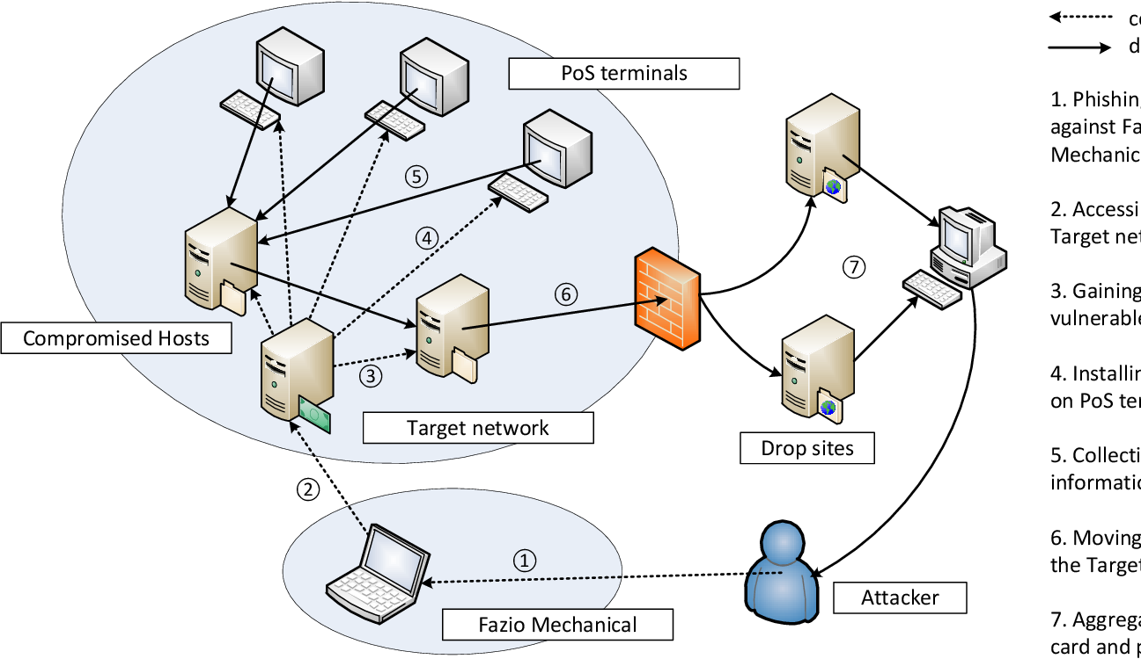
Case Study#4- Target Data Breach

Slide 3

Introduction
In 2013, Target experienced a significant data breach affecting millions of customers.
A security hole allowed criminals to access customer credit card information.
Customers' personal and financial information from Target was lost as a result of the hack.
The breach had a serious negative effect on both the business and its clients.
The operating system's flaws made the attack more likely.
To ensure that such situations don't happen again, preventative actions should be performed.

Slide 4
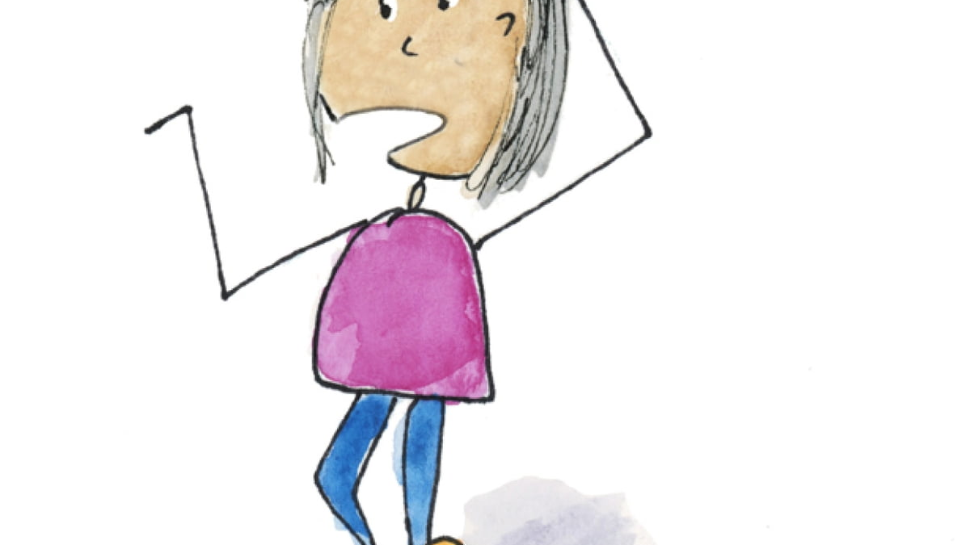
What happened?
Target did not reveal the data breach until December 15, despite the fact that the attack had been going on since November 27.
Millions of customers were badly impacted by the attack, which had already inflicted harm. The impact on customers could have been increased by the delay in notifying the breach.
The hackers were successful in obtaining a variety of financial and personal data, including credit and debit card information.
The response from Target to the incident was criticized for being ineffective and delayed.

Slide 5
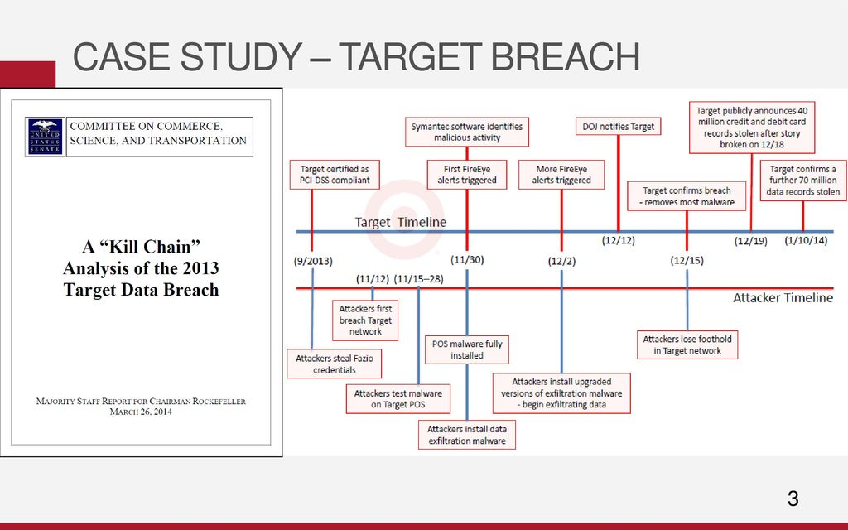

Slide 6
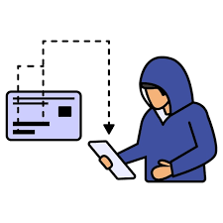
Who was affected?
The Target security breach exposed the private data of around 40 million customers who made purchases there between November 27 and December 15, 2013. Names, addresses, contact details (phone and email), and credit/debit card information were all included. Customers complained about fraudulent transactions and the improper use of their personal data. Target's brand reputation and financial standing suffered as a result of having to pay millions of dollars in fines and compensation.

Slide 7
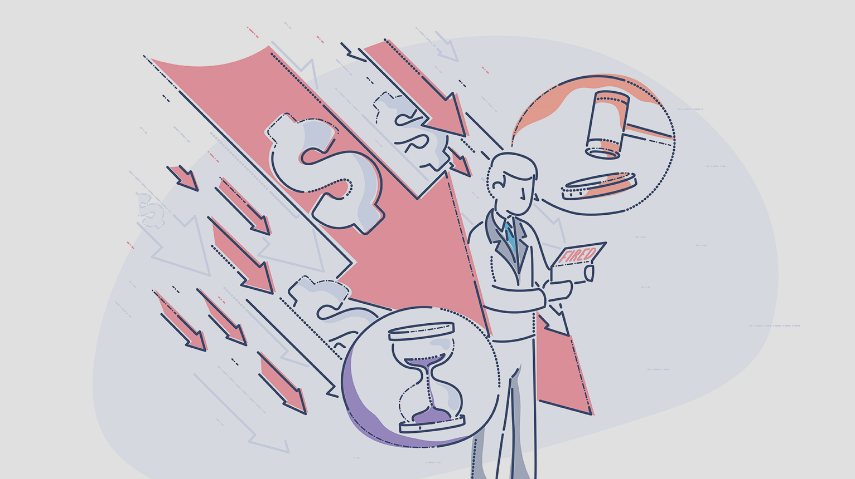
What portion of the operation system vulnerability contribute to the attack?
Target experienced a data breach as a result of a combination of operational and technical issues that the company failed to address despite being aware of the vulnerability.
One of the most important weaknesses in the way the company conducted business was its inability to appropriately safeguard its systems from illegal access by outside providers.
By obtaining login information from a vendor, hackers were able to enter Target's servers and put malware on the point-of-sale system.

Slide 8
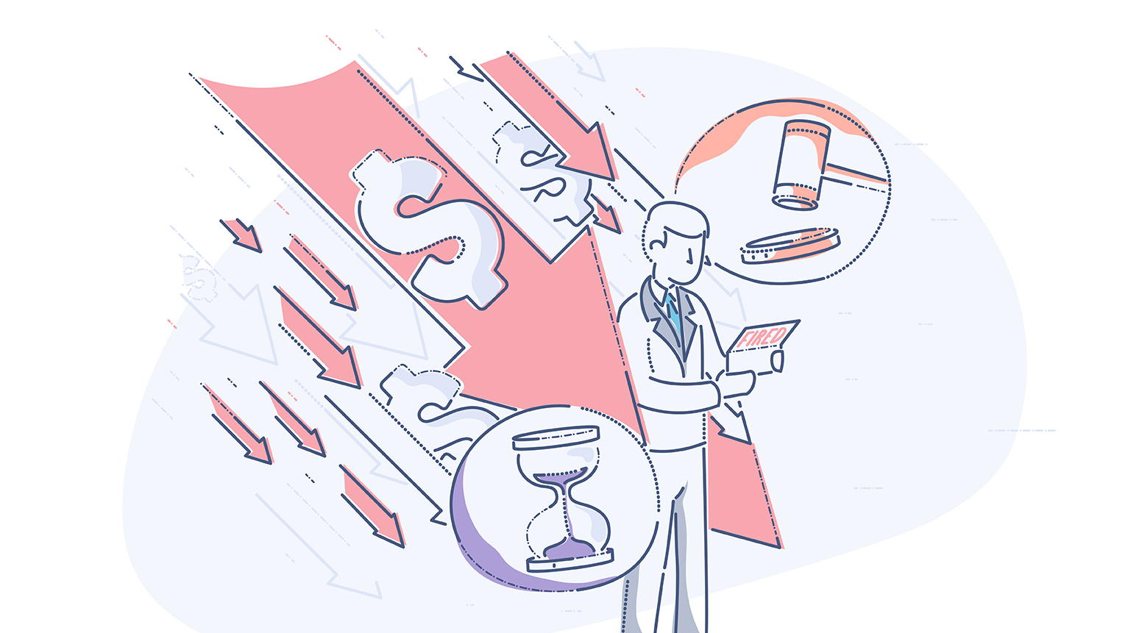
What portion of the operation system vulnerability contribute to the attack?
The company's systems were not adequately segregated and monitored, allowing hackers to move laterally and compromise the organization.
The company's network was more vulnerable to hacking because of the lax password policy and absence of two-factor authentication.
The organization did not use a system that required authentication through a combination of more than one factor.

Slide 9
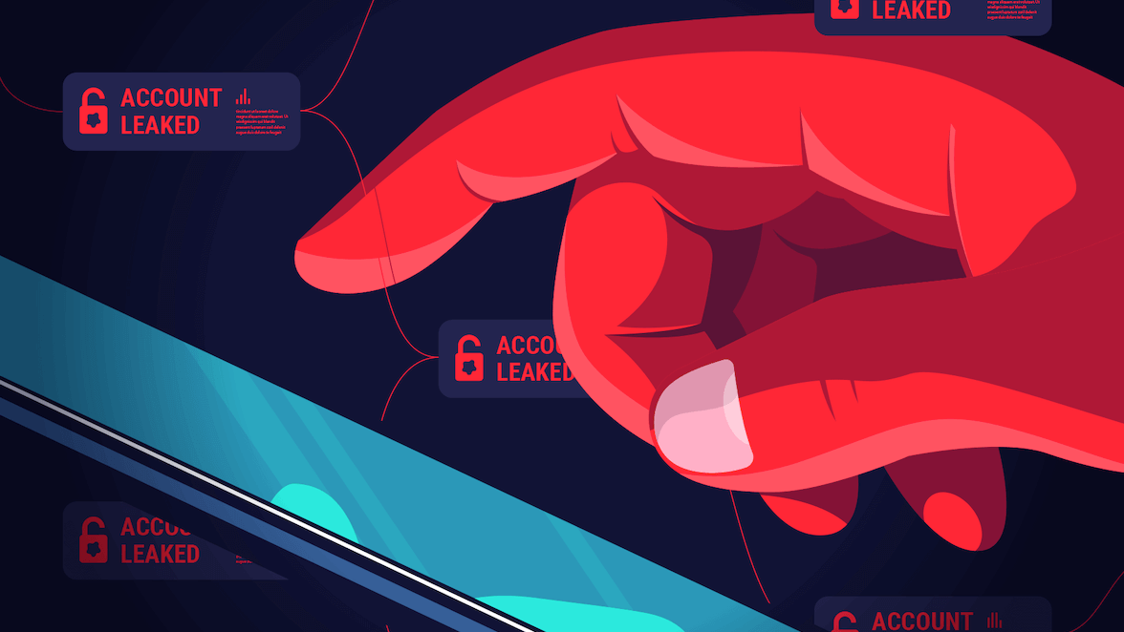
What can be done to prevent the attack?
Millions of customers were adversely affected by the 2013 Target data breach, which had a detrimental effect on the company's reputation and bottom line. Businesses can take the following steps to safeguard themselves from upcoming attacks:
To secure the credentials of their employees, employers impose strict restrictions on the usage of passwords. Employees should create strong, one-of-a-kind passwords and use two separate authentication methods.
Networks into distinct sections to prevent lateral movement and installing monitoring systems to find and address security breaches. Computer system compartmentalization facilitates internal monitoring.

Slide 10
What can be done to prevent the attack?
Doing thorough background checks on third-party providers and keeping a close eye on their performance to make sure they adhere to the most recent security best practices and do not endanger the organization.
Doing regular security audits and penetration tests to find any potential security flaws and then taking the necessary corrective action. This assists in locating any security holes in the system and confirming that the necessary safety precautions are consistently being implemented.
Providing staff employees with frequent, dependable education in topics of safety and security.

Slide 11
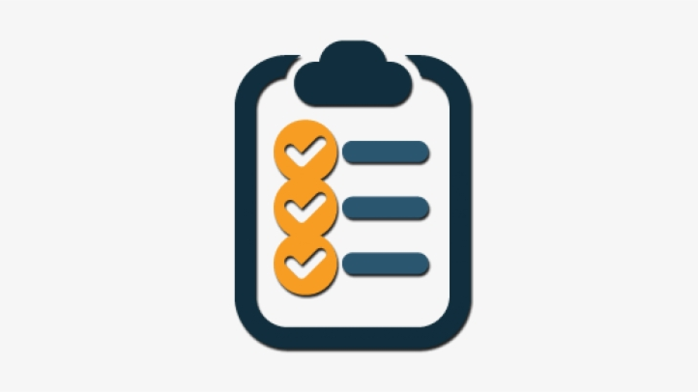
Conclusion
The reputation and financial health of Target were significantly impacted by the 2013 data leak. It happened because of bad security procedures such lax access limits, a lack of system monitoring, and lax password policies. By implementing best security practices including stringent password requirements, system segmentation and monitoring, third-party supplier screening and monitoring, frequent security audits, and staff education, businesses can avoid similar situations in the future. These steps can safeguard consumer information and lessen the likelihood of a data breach.

Slide 12

References
https://redriver.com/security/target-data-breach#:~:text=What%20Happened%20During%20the%20Target,was%20one%20of%20the%20largest.
https://slate.com/technology/2022/04/breached-excerpt-hartzog-solove-target.html
https://www.usatoday.com/story/money/2017/05/23/target-pay-185m-2013-data-breach-affected-consumers/102063932/
https://www.idstrong.com/sentinel/that-one-time-target-lost-everything/
https://www.usatoday.com/story/money/2017/05/23/target-pay-185m-2013-
data-breach-affected-consumers/102063932/
https://krebsonsecurity.com/2015/09/inside-target-corp-days-after-2013-
breach/
https://www.lifelock.com/learn/data-breaches/target-data-breachvictims-could-get-up-to-10000

Slide 13

Thank you.

